Slide 1
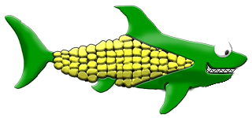


Slide 2
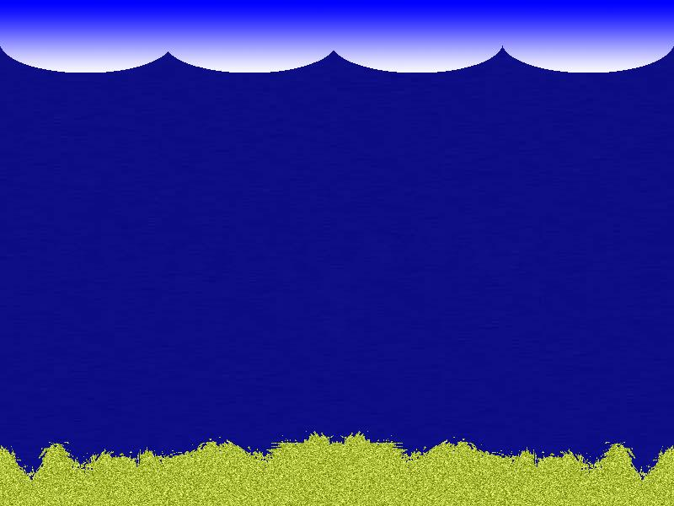
What is ?
A casual action game set in a fictional undersea world.
  Play as a plant/animal hybrid sea creature who must avoid being eaten while trying to become the biggest fish in the sea.
  Features colorful and whimsical characters that will appeal to players of all ages.

Slide 3
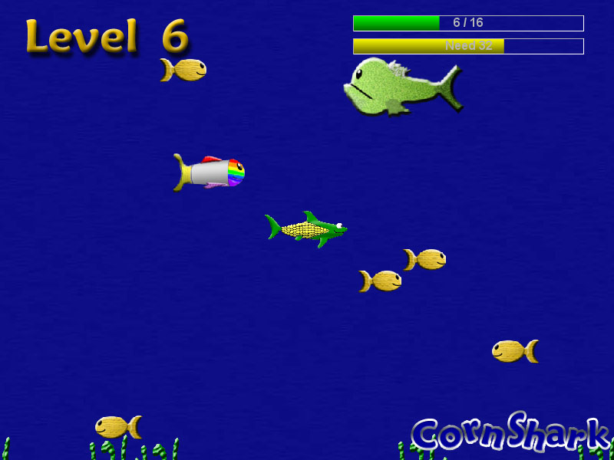
Gameplay
Eat fish
Level up
Avoid predators
Game ends when:
  Player reaches Lvl. 16 (Victory)
  Player loses all points at Lvl. 0 (Defeat)

Slide 4




Power-Ups
Eating certain fish will temporarily enhance the player character.
  Score multiplier
  Speed boost
  Invincibility
  Instant level-up
Except for the instant level-up, all power-up effects last 10 – 15 seconds.

Slide 5



Difficulty Levels
Easy: Small game world, low chance of predators, fish have short “sensor range”.
Normal: Default setting
Hard: Large game world, high chance of predators, fish have long “sensor range”.

Slide 6

Visit the official
CornShark Web site:
http://www.CornSharkGame.com

